Slide 1
1

Slide 2

APPLIED CRYPTOGRAPHY
Lecture 49
2

Slide 3
Elliptic Curve Cryptosystems
Small key more security
3

Slide 4
Contents
Introduction to ECC (Elliptical Curve Cryptography)

Slide 5

Elliptic curves over Real numbers
The general equation for an elliptic curve is
$$y^{2}+b_{1}xy+b_{2}y= x^{3}+a_{1}x^{2}+a_{2}x+a_{3}$$
For current cryptographic purposes, an elliptic curve is a plane curve over a finite field (rather than the real numbers) which consists of the points satisfying the equation
$y^{2}=x^{3}+ax+b$ along with a distinguished point at infinity, denoted ∞.

Slide 6
Point at infinity
In geometry, a point at infinity or ideal point is an idealized limiting point at the "end" of each line.
In the case of an affine plane, there is one ideal point for each pencil of parallel lines of the plane. Adjoining these points produces a projective plane, in which no point can be distinguished

Slide 7
The two most prominent protocols based on ECC
Elliptic Curve Discrete Signing Algorithm (ECDSA) for digital signature
Elliptic Curve Diffie-Hellman (ECDH) for key agreement

Slide 8
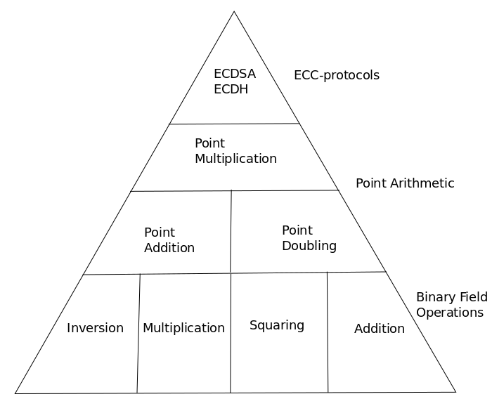
The hierarchy of ECC

Slide 9
Prime Field Operations
Field operations include addition, subtraction, multiplication and inversion modulus a prime p, and form the lowest level in the ECC hierarchy.
For these algorithms, assume a W-bit architecture, where W can be 8 or 16 for embedded devices and 32 or 64 for most computers.
To represent larger numbers than W bits, divide the n bits into t = n/W words and carry out the algorithms on each word.

Slide 10
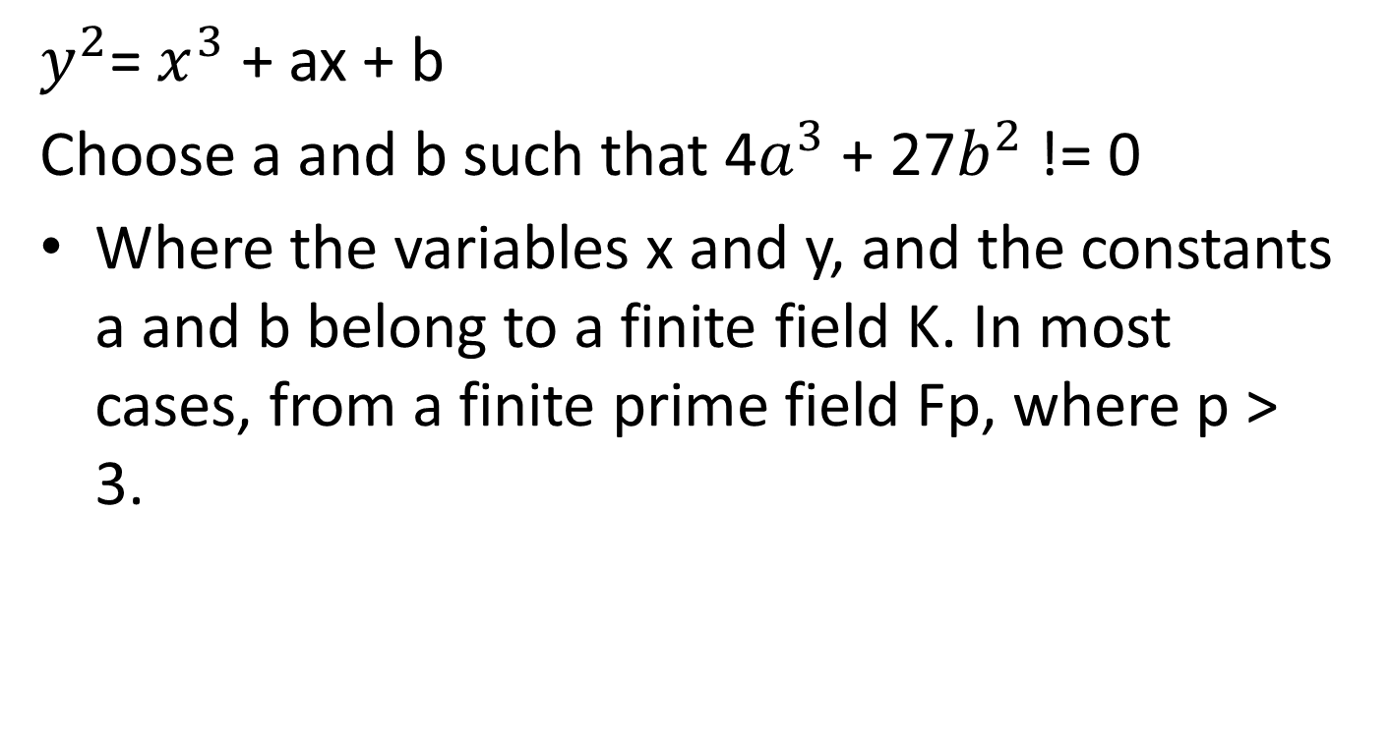
short Weierstrass equation
$y^{2}$= $x^{3}$ + ax + b
Choose a and b such that 4$a^{3}$ + 27$b^{2}$ != 0
Where the variables x and y, and the constants a and b belong to a finite field K. In most cases, from a finite prime field Fp, where p > 3.

Slide 11
Can the value be A=-3 b=2

Slide 12
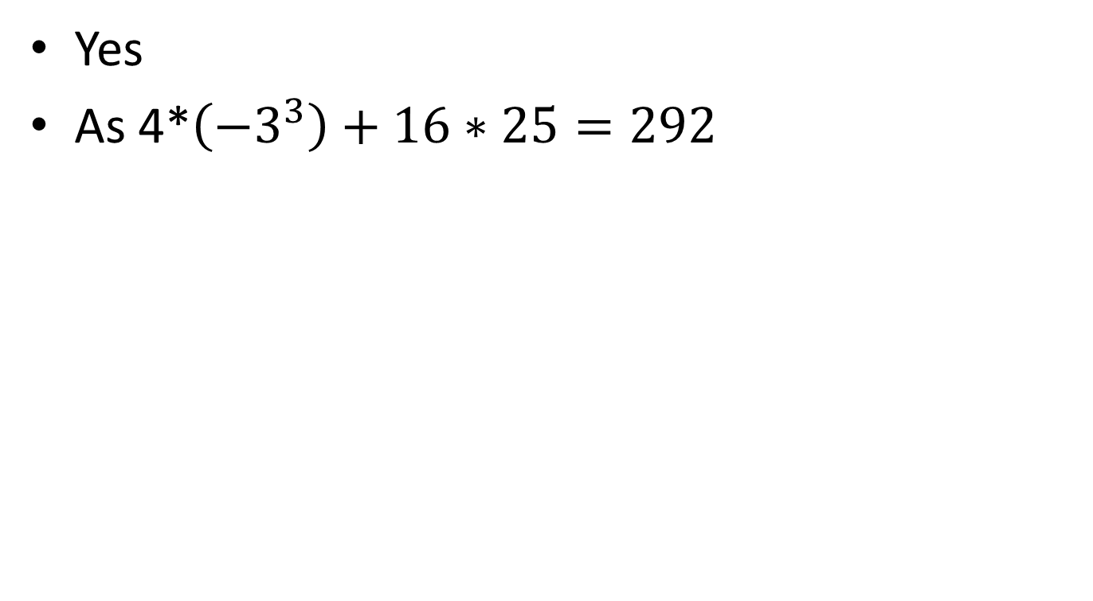
Can the value be A=-3 and B=5
Yes
As 4*$\left({−3}^{3}\right)+16∗25=292$

Slide 13
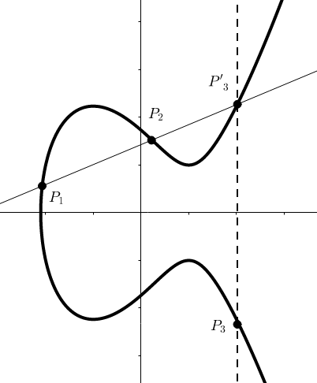
Adding points on an elliptic curve

Slide 14
Point at infinity
if P1 = P2
y-coordinate equal zero, then the tangent line would not intersect any other point on E (K), other than the point itself.
For that reason, the point at infinity(1) is added as the identity element. This point can be viewed as being the top and bottom of the y-axis.

Slide 15
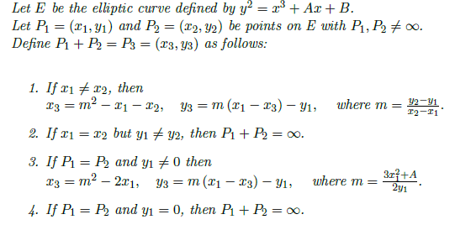
The elliptic curve group operation

Slide 16
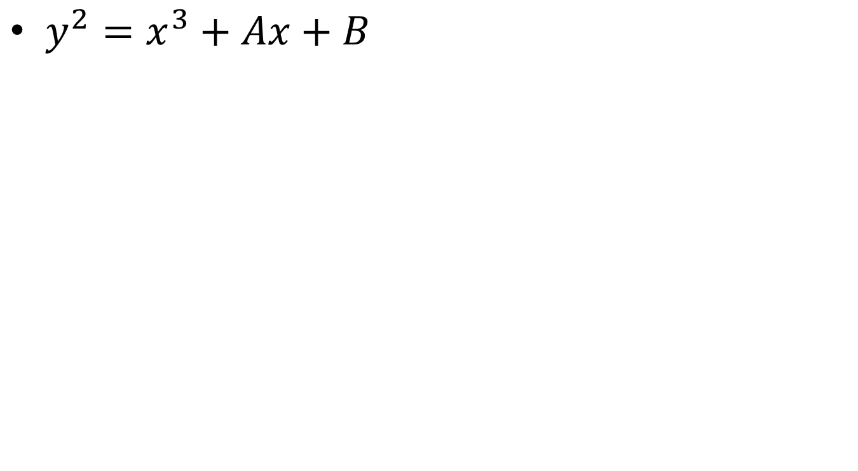
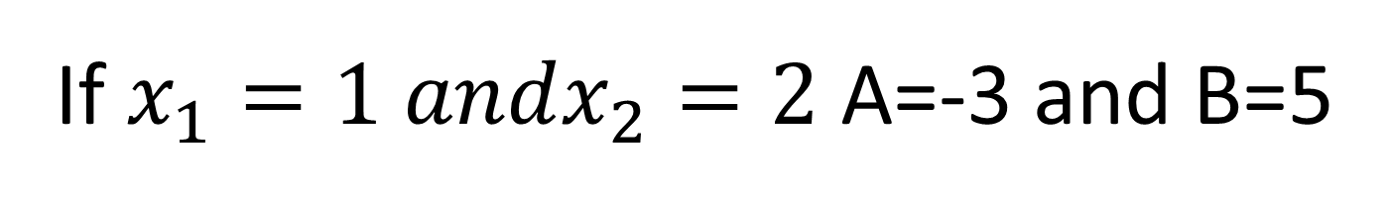
If $x_{1}=1 andx_{2}=2$ A=-3 and B=5
$$y^{2}=x^{3}+Ax+B$$

Slide 17
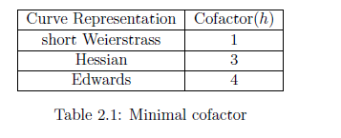

Slide 18
Coordinate Systems
affine coordinates (x,y plane)
Projective Coordinates(x,y,z plane)
In the cases where z != 1 and z != 0, the projective point can be normalized by dividing by z: (x : y : z) = (x/z : y/z : 1).

Slide 19

Edwards Curves
the projective inverted twisted Edwards curve equation used in Miracl Cryptolibrary
Given a point (x : y : z), with z != 0 the inverse of that point is defined: (-x : y : z :). If z = 0 then this is the point at infinity.
Note that the point (x : y : z :) on a twisted Edwards curve corresponds to the affine point (z/x; z/y) on the twisted inverted Edwards curve

Slide 20
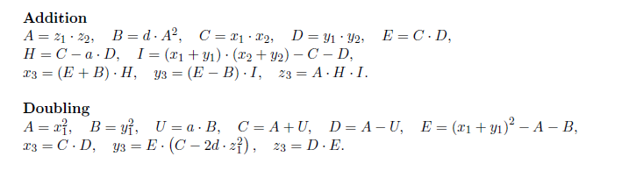
Double and Add Formula for Twisted Inverted Edwards Curves

Slide 21


Hessian Curves
Curve represented by the equation

Slide 22
Hessian Curves
The point at infinity in this curve representation will be (0 : -1 : 1). Hence, the algorithm
for normalizing a point will be shifted to the following:
All points with x = 0 will be points at infinity. If not, the point can be normalized by
dividing with x: (1 : y/x : z/x).

Slide 23
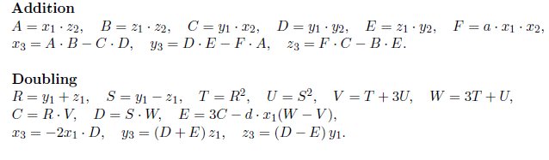
Double and Add Formula for Twisted Hessian Curves

Slide 24
Point Compression
The y-coordinate of a normalized point (x : y : 1) on a Weierstrass curve can be compressed by storing only the x-coordinate and the last significant bit (LSB) of the y-coordinate.

Slide 25
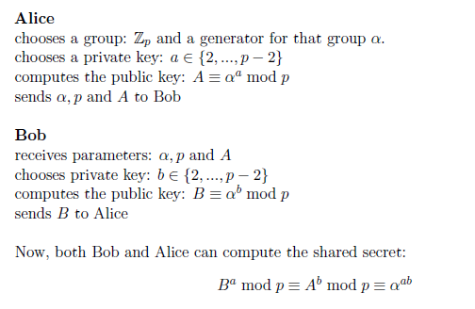
Discrete Logarithm Problem(DLP) ECDH

Slide 26
Man in the middle attack
To find the private key x, an attacker would need to calculate the discrete logarithm: x = log x mod p. This problem establishes the backbone for most public key systems and also ECC.

Slide 27
Thank You!
Next Class
Mandatory reading for the next class
https://nvlpubs.nist.gov/nistpubs/FIPS/NIST.FIPS.186-4.pdf
27

Slide 28


Rajashree S
Computer Science and Engineering
PES University, Bengaluru
10 June 2020
28

